Slide 1
Client-Server Architecture

Slide 2
Learning Objectives
Define client server architecture and its components including the unique roles of the client, the server and communications networks.
Describe different types of client-server architecture and their associated features.
Discuss different types of servers and the role of middleware in distributed systems.
Notes:
Students may not know exactly what is meant by globalization or may have an incomplete understanding of the term. You might ask students what they think it means. Potential answers could include: reduction of economic and cultural advantages of developed countries, increased number of companies with operations in multiple countries worldwide, and increased reliance on imports and exports of goods (and jobs). Globalization will be discussed in later slides as well.

Slide 3
Client-Server Architecture
Introduction
  Definition
  Components
  Middleware
The Client-Server Architecture
Performance Optimization
  Application Partitioning
  Parallel Computer Architectures
Middleware

Slide 4

Definition
A network architecture in which each computer or process on the network is either a client or a server.
Figure 1-1: Definition

Slide 5
Client-Server Systems
Operate in a networked environment.
Processing of an application distributed between front-end clients and back-end servers.
Generally the client process requires some resource, which the server provides to the client.
Clients and servers can reside in the same computer, or they can be on different computers that are networked together, usually:
  Client – Workstation (usually a PC) that requests and uses a service.
  Server – Computer (PC/mini/mainframe) that provides a service. For DBMS, server is a database server.

Slide 6
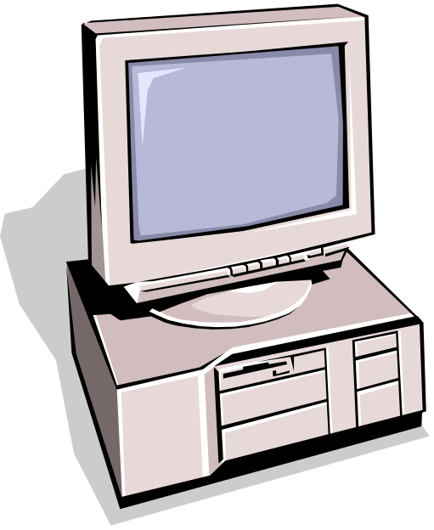

Components
Clients
Servers
Communication Networks
Server
Client
Figure 1-2: Components

Slide 7
Clients
Applications that run on computers
Rely on servers for:
  Files
  Devices
  Processing power
Example: E-mail client
  An application that enables you to send and receive e-mail.
Clients are Applications

Slide 8
Servers
Computers or processes that manage network resources.
  Disk drives (file servers)
  Printers (print servers)
  Network traffic (network servers).
Example: Database Server
  A computer system that processes database queries
Servers Manage Resources

Slide 9
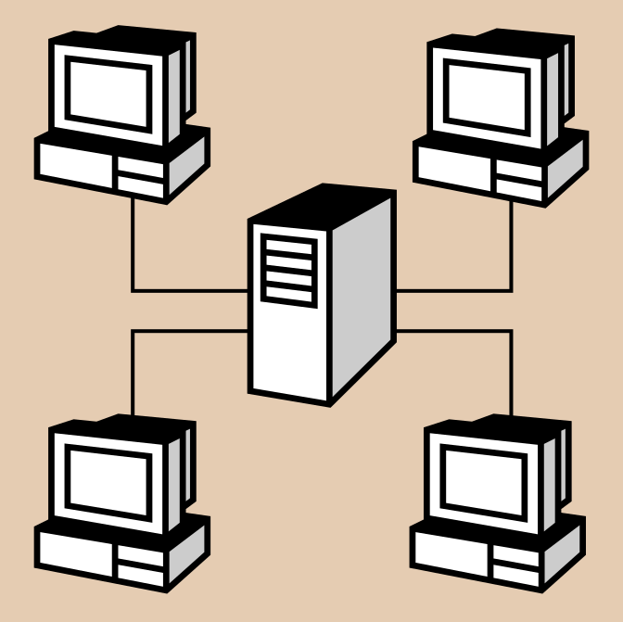


Communication Networks
Networks Connect Clients and Servers
Figure 1-3: Communication Networks

Slide 10
Client-Server Computing
Process takes place
  on the server and
  on the client
Servers
  Store and protect data
  Process requests from clients
Clients
  Make requests
  Format data on the desktop
Client-Server Computing Optimizes Computing Resources

Slide 11
Application Functions
Software application functions are separated into three distinct parts:
Server:
Data Management
Client: Presentation & Application Logic
Figure 1-4: Application Functions

Slide 12
3 Components of Application Logic
Input: output or presentation logic component – responsible for formatting and presenting data on the user’s screen (or other output device) and managing user input from keyboard (or other input device).
Processing Logic Component: handles data processing logic (validation and identification of processing errors), business rules logic, and data management logic (identifies the data necessary for processing the transaction or query).
Storage Logic Component: responsible for data storage and retrieval from the physical storage devices – DBMS activities occur here.

Slide 13
Application Components
3
Data Management
2 Client Types
2
Application Logic
Fat
Client
1
Presentation
Thin
Client
3 Logical Tiers
Database Applications:
  Most common use of client-server architectures
Figure 1-5: Application Components

Slide 14
Middleware
Software that connects two otherwise separate applications
Example: Middleware product linking a database system to a Web server
Database Server:
Manages Data
Middleware Links Applications
Web Server:
Presents Dynamic Pages
Client: Requests Data via Web
Figure 1-6: Middleware

Slide 15
Types of Servers
From A to Z
Application Servers
Audio/Video Servers
Chat Servers
Fax Servers
FTP Servers
Groupware Servers
IRC Servers
List Servers
Mail Servers
News Servers
Proxy Servers
Telnet Servers
Web Servers
Z39.50 Servers

Slide 16
Client-Server Architecture
Introduction
  Definition
  Components
  Middleware
The Client-Server Architecture
Performance Optimization
  Application Partitioning
  Parallel Computer Architectures
Middleware

Slide 17
Client-Server Architecture
File Server Architecture
Database Server Architecture
Three-tier Architecture
Client does extensive processing
Client does little processing

Slide 18
File Server Architecture
The first client-server architectures developed.
All processing is done at the PC that requested the data, i.e. the client handles the presentation logic, the processing logic and much of the storage logic.
A file server is a device that manages file operations and is shared by each of the client PCs attached to the LAN.

Slide 19
File Server Architecture…
Each file server acts as an additional hard disk for each of the client PCs.
Each PC may be called a FAT CLIENT (most processing occurs on the client).
Entire files are transferred from the server to the client for processing.

Slide 20
Problems with the File Server Architecture
Huge amount of data transfer on the network, because when client wants to access data whole table(s) transferred to PC – so server is doing very little work, network is transferring large blocks of data and client is busy with extensive data manipulation.
Each client is authorized to use the DBMS when a database application program runs on that PC. Thus there is one database but many concurrently running copies of the DBMS (one on each active PC) – so heavy resource demand on clients.

Slide 21
Problems with File Server Architecture…
The DBMS copy in each client PC must manage the shared database integrity, i.e. Client DBMSs must recognize shared locks, integrity checks, etc. So programmers must be sophisticated to recognise various subtle conditions that can arise in a multiple-user database environment, as have to understand overview of concurrency, recovery and security controls and build these into their application.

Slide 22
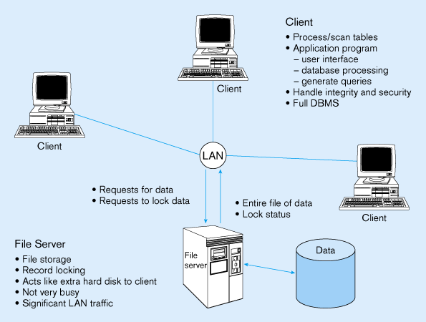
File Server Architecture…
FAT CLIENT
Figure 1-7: File Server Architecture

Slide 23
Client-Server Architecture
File Server Architecture
Database Server Architecture
Three-tier Architecture
Client does extensive processing
Client does little processing

Slide 24
Database Server Architecture
After the file-server approach came two-tiered approaches.
Client is responsible for managing user interface, I/O processing logic, data processing logic and some business rules logic (front-end programs).
Database server performs all data storage and access processing (back-end functions) – DBMS is only on server

Slide 25
Database Server Architecture…
Advantages:
  Clients do not have to be as powerful, only the database server requires processing power adequate to handle the database – therefore the server can be tuned to optimise data processing performance.
  Greatly reduces data traffic on the network, as only those records (rather than tables) that match the requested criteria are transmitted to the client.
  Improved data integrity since it is all processed centrally.

Slide 26
Stored Procedures…
These are modules of code that implement application logic, which are included on the database server. They have the following advantages:
  Performance improves for compiled SQL statements.
  Reduced network traffic as processing moves from the client to the server.
  Improved security if the stored procedure is accessed rather than the data and code being moved to the server.
  Improved data integrity as multiple applications access the same stored procedure.
  Thinner clients (and a fatter database server).

Slide 27
Stored Procedures…
They have some disadvantages:
  Writing stored procedures takes more time than using something like VB.
  Proprietary nature reduces portability.
  Performance degrades as number of on-line users increases.

Slide 28
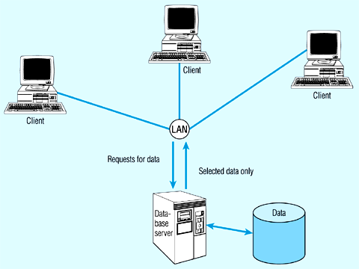
Database Server Architecture
Thinner clients
DBMS only on server
Figure 1-8: Database Server Architecture

Slide 29
Client-Server Architecture
File Server Architecture
Database Server Architecture
Three-tier Architecture
Client does extensive processing
Client does little processing

Slide 30
Three-tier Architecture
In general, this includes another server layer in addition to the client and database server.
This additional server may be used for different purposes.
Often application programs reside on the additional server (the application server).
Or additional server may hold a local database whilst another server holds the enterprise database.
Often a Thin Client - PC just for user interface and a little application processing. Limited or no data storage (sometimes no hard drive).

Slide 31
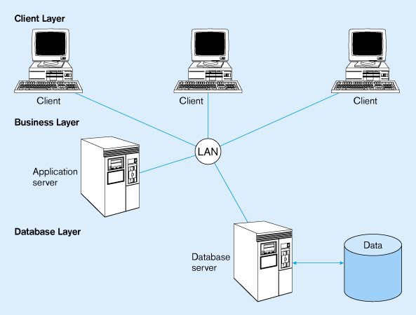
Three-tier Architecture
Thinnest clients
Business rules on separate server
DBMS only on DB server
Figure 1-9: Three-tier Architecture

Slide 32
Advantages of Three-tier Architecture
Scalability: middle tier can be used to reduce the load on a database sever by using a transaction processing (TP) monitor to reduce the number of connections to a server, and additional application servers can be added to distribute application processing.
Technological flexibility: easier to change DBMS engines – middle tier can be moved to a different platform. Simplified presentation interfaces make it easier to implement new interfaces.

Slide 33
Advantages of Three-tier Architecture…
Long-term cost reduction: use of off-the-shelf components or services in the middle tier can reduce costs, as can substitution of modules within an application rather than a whole application.
Better match of systems to business needs: new modules can be built to support specific business needs rather than building more general, complete applications.
Improved customer service: multiple interfaces on different clients can access the same business process.

Slide 34
Advantages of Three-tier Architecture…
Competitive advantage: ability to react to business changes quickly by changing small modules of code rather than entire applications.

Slide 35
Challenges of Three-tier Architecture
High short-term costs: presentation component must be split from process component – this requires more programming.
Tools, training and experience: currently lack of development tools and training programmes, and people experienced in the technology.
Incompatible standards: few standards yet proposed.
Lack of compatible end-user tools: many end-user tools such as spreadsheets and report generators do not yet work through middle-tier services (see later discussion on middleware).

Slide 36
Client-Server Architecture
Introduction
  Definition
  Components
  Middleware
The Client-Server Architecture
Performance Optimization
  Application Partitioning
  Parallel Computer Architectures
Middleware

Slide 37
Application Partitioning
Placing portions of the application code in different locations (Client vs. Server) AFTER it is written. Has the following advantages:
  Improved performance.
  Improved interoperability.
  Balanced workloads across the tiers.
  OO development very suitable for this.
  Necessary in the Web environment, in order to achieve desired performance in an unpredictable distributed environment.

Slide 38
Parallel Computer Architectures…
The ability to handle high transaction volumes, complex queries and new data types has proven problematic in many uniprocessor environments. But RDBMS and SQL lend themselves to a parallel environment in 2 ways (see Figure 1-10):
  In most queries, SQL acts as a nonprocedural set processing language – this means that queries can be divided into parts, each of which can then be run on a different processor simultaneously.
  Multiple queries can be run in parallel on parallel processors.

Slide 39
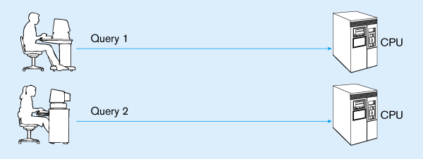
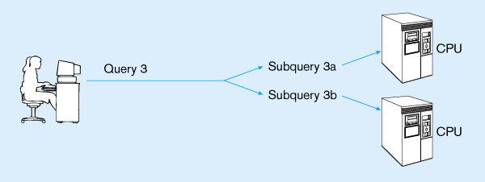
Query processing with Parallel Processors
Parallel transactions
Parallel query
Figure 1-10: Three-tier Architecture

Slide 40
Parallel Computer Architectures…
Tightly Coupled multiprocessor systems have a common shared memory (RAM) among all processors, and are often called Symmetric Multiprocessing (SMP) architectures. They have some advantages:
  Single copy of the operating system resides in the shared memory.
  Bottlenecks are lessened compared to uniprocessor systems because all processors share all tasks.
  Useful for situations where data must remain in memory during processing to achieve the desired performance level – but potential problems of contention for the shared memory.

Slide 41
Parallel Computer Architectures…
Loosely Coupled architectures, also called Massively Parallel Processing (MPP) are where each CPU has its own RAM space.
Require a copy of the operating system to be resident in each dedicated memory.
Less problems with memory contention, allows more scalability – easier to add nodes incrementally than SMP.
Basically applications that have large tasks that can be divided up and worked on simultaneously that are best suited to MPP architectures, rather than applications that can benefit from the use of shared memory.

Slide 42
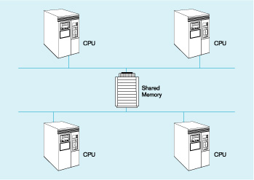
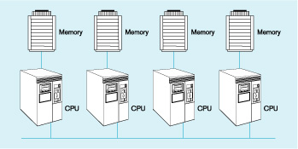
Parallel Computer Architectures…
Tightly-coupled – CPUs share common memory space
Loosely-coupled – CPUs each have their own memory space
Figure 1-11: Tightly-coupled vs Loosely-coupled CPUs

Slide 43
Client-Server Architecture
Introduction
  Definition
  Components
  Middleware
The Client-Server Architecture
Performance Optimization
  Application Partitioning
  Parallel Computer Architectures
Middleware

Slide 44
Middleware
Software which allows an application to interoperate with other software, without requiring the user to understand and code the low-level operations required to achieve interoperability.
With Synchronous systems, the requesting system waits for a response to the request in real time.
Asynchronous systems send a request but do not wait for a response in real time – the response is accepted whenever it is received.
The “glue” that holds client/server applications together

Slide 45
Types of Middleware…
Asynchronous Remote Procedure Calls (RPC): client makes calls to procedures running on remote computers but does not wait for a response. If connection is lost, client must re-establish the connection and send request again. High scalability but low recovery, largely replaced by Synchronous RPC below.
Synchronous RPC: distributed program using this may call services available on different computers – makes it possible to achieve this without undertaking detailed coding (e.g. RMI in Java).

Slide 46
Types of Middleware…
Publish-Subscribe: often called push technology, here server monitors activity and sends information to client when available. It is asynchronous, the clients (subscribers) perform other activities between notifications from the server. Useful for monitoring situations where actions need to be taken when particular events occur.
Message-Oriented Middleware (MOM): sends messages that are collected and stored until they are acted upon, while the client continues with other processing.

Slide 47
Types of Middleware…
Object Request Broker (ORB): object-oriented management of communications between clients and servers. ORB tracks the location of each object and routes requests to each object.
SQL-oriented Data Access: middleware between applications and database servers. Has the capability to translate generic SQL into the SQL specific to the database.

Slide 48
Database Middleware
ODBC – Open Database Connectivity: most DB vendors support this.
OLE-DB – Object Linking & Embedding DB: Microsoft enhancement of ODBC.
JDBC – Java Database Connectivity: special Java classes that allow Java applications/applets to connect to databases.
CORBA – Common Object Request Broker Architecture: specification of object-oriented middleware
DCOM – Microsoft’s version of CORBA: not as robust as CORBA over multiple platforms.

Slide 49
Using ODBC to link external DBs on a DB server
Figure 1-12: shows a generic ODBC architecture.
Client application requests that a connection is established with a data source.
Driver manager identifies appropriate ODBC driver to use.
Driver selected will process the requests received from the client and submit queries to the RDBMS in the required version of SQL.
Java Database Connectivity (JDBC) is similar to ODBC – built specifically for Java applications.

Slide 50
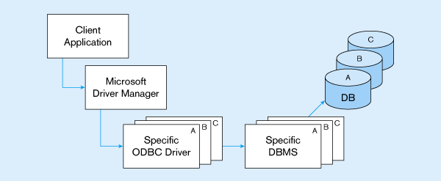
ODBC Architecture
Client does not need to know anything about the DBMS
Application Program Interface (API) provides common interface to all DBMSs
Each DBMS has its own ODBC-compliant driver
Figure 1-12: Tightly-coupled vs Loosely-coupled CPUs

Slide 51
Client-Server Security
Network environments have complex security issues. Networks are susceptible to breaches of security through eavesdropping, unauthorised connections or unauthorised retrieval of packets of information flowing round the network. Specific security issues include:
  System-level password security: user names and passwords for allowing access to the system using Password management utilities.
  Database-level password security: for determining access privileges to tables; read/update/insert/delete privileges.
  Secure client/server communication via encryption: but encryption can negatively affect performance.

Slide 52
Database access from Client Applications
Partitioning the environment to create a two, three or n-tier architecture means that decisions must be made about the placement of the processing logic.
In each case, storage logic (the database engine) is handled by the server, and presentation logic is handled by the client.
Part a) of Figure 1-13 depicts some possible 2-tier systems, placing the processing logic on the client (fat client), on the server (thin client) or partitioned across both the server and the client (a distributed environment).

Slide 53
Database access from Client Applications
Part b) of Figure 1-13 Depicts a typical 3-tier architecture and an n-tier architecture
Some processing logic could be placed on the client if desired
But a typical client in a Web enabled environment will be a thin client, using a browser for its presentation logic
The middle tiers are typically coded in a portable language such as Java

Slide 54
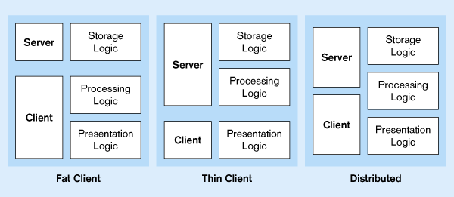
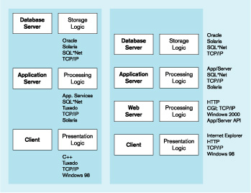
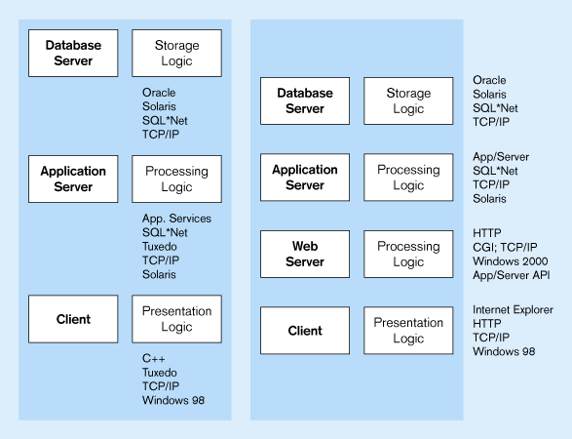
Processing Logic Distributions
a) 2-tier
Processing logic could be at client, server, or both
Processing logic will be at application server or Web server
b) 3 and n-tier
Figure 1-13: Processing Logic Distr. in 2-tier & 3-tier Architectures

Slide 55
Summary
Introduction
  Client-Server Architecture
  Components
  Middleware
The Client/Server Database Environment
Performance Optimization
  Application Partitioning
  Parallel Computer Architectures
Middleware & Types

Slide 56
Group Projects
Introduction
Allocations
Logistics
Discussion

Slide 57
Next Week……
Google File System (GFS)
Assignment II

